Slide 1
Mōkai Pātea Waitangi Claims Trust Hui-a-Rohe Hybrid Hui
14 August 2022 REAP Taihape & Webinar
11 am – 12 pm

Slide 2
Overview
Mihi / Welcome
Housekeeping
Update from previous hui a rohe (27 March 2022)
Waitangi Tribunal hearings update
Settlement Negotiations update
Q&A Session - Questions using the Q&A button and the Webinar Facilitator (Lavinia) will put the questions to the panel.

Slide 3
Housekeeping
Attendance register (online and a tinana)
Multiple attendance through the one registration? Please use the Q&A button and list the names of whanau attending with you, their hapū/iwi if different to yours).
Webinar is recorded, the presentation part of the webinar (video) and a pdf of the presentation made available on website. Website address: https://mokaipateaclaims.maori.nz/documents/
No videoing, sharing through live feeds.
No permission for anyone external to MPWCT recording this hui or the use of screen shots for sharing.
Breaching either points 4 or 5 will see you removed from the online meeting and may prevent your participation in future meetings.

Slide 4
Hui process
Apologies
MPWCT team (BOT & Contractors & Negotiators)
Presentation, followed by Q & A session
Use the Q & A button to type your Questions
Online queries will be presented to the Panel at the end of the presentation.
The hui will close at 12 pm
Panelists Utiku Potaka MPWCT Chair, Negotiators

Slide 5
Mōkai Pātea Waitangi Claims Trust
Trustees
Ngāti Whitikaupeka - Barbara Ball, Te Rina Warren
Ngāti Tamakōpiri - Hari Benevides, Moira Raukawa-Haskell
Ngāi Te Ohuake – Maraea Bellamy, Robert Martin
Ngāti Hauiti - Utiku Potaka, Peter Fraser
Tumu Mōkai – Vacant
Management Team
Programme Manager – Lavinia Jacobsen
Strategic Advisor – Richard Steedman
Legal Advisor – Leo Watson
Administration Services – Contract with Mōkai Pātea Services (MPS)
Notes:
Acknowledge Thomas Curtis contribution as Ngāti Hauiti Delegate for (how many years) welcome Peter Fraser

Slide 6
MPWCT Trusteeship
Trustees confirmed in 2019
Each Trustee serves a term of 4 years
Rotation of one Trustee from each iwi made after 2 years
Existing Trustees eligible to be re-appointed
New Trustees during this term:
Robert Martin
Hare Benevides
Peter Fraser
NOTE: 2023 Phase II Rūnanga delegate elections for hapū seats
Notes:
On 9 November 2021, Negotiators were appointed by the Trust after a call for nominations through Mōkai Pātea iwi Rūnanga
The process including candidates requiring endorsement from an iwi Rūnanga.

Slide 7
Waitangi Tribunal claims update
Hearing's process concluded October 2021
No decision yet on Gwavas/Kaweka
Tribunal write their report
Tribunal may release an early Landlocked Lands report in the next few months

Slide 8
DIRECT NEGOTIATIONS ROADMAP
2017 DRAFT
Strategy
MANDATE
Vote 2019
Draft Deed
Mandate Advertised
May 2020
PRE
MANDATE
Submissions
Evidence & Research Developed & Participation in Waitangi Claims Hearings 2016 - 2021
Submissions
WE ARE HERE
Deed of
Mandate Mar 2021
AIP
TON
Agreement In Principle
Terms of Negotiations
DOS
Deed of Settlement
IWI
RATIFY
LEGISLATION
IMP
DOA
PSGE
Post Settlement Governance Entity
Settlement Legislation
Implementation & Distribution of Assets
Hui a Rohe 2022-03-27 (c) 2022 Mōkai Pātea Waitangi Claims Trust

Slide 9
Iwi Support to Negotiators
Marae - ToWN Ministers visit in March
Wānanga - Identification of Crown Lands potentially available for Negotiation
Research - Identification of shared interests in adjoining land blocks which are not part of the ‘core’ Mōkai Pātea claims
Research - Development of a comprehensive land ownership register of tupuna from the 1800’s
Rūnanga – reviewing Trust charter which outlines general principles of the distribution of assets and/or financial returns from settlement

Slide 10
Negotiators Summary
Developed Narrative & Framework for Negotiations Te Ara A Pokokura
Negotiations hui
Ministers Visits - of ToWN and CCN visit to rohe March and MoD on Friday
MPs connected with Mōkai Pātea
MPWCT Negotiating Team appointed
Che Wilson
Richard Steedman
Tama Potaka
Tracey Hiroa
Crown Chief Negotiator
Katherine Gordon (Resigned February 2022)
Glenn Webber (Resigned 10 March 2022)
David Tapsell 1 April 2022)
Appointed Nov 2021

Slide 11
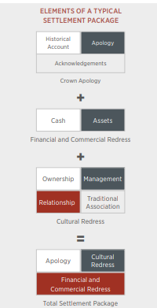
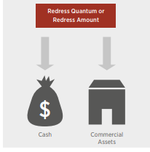
Redress
Quantum does not include:
Redress Gifted by the Crown i.e Wāhi tapu
Rights & Processes such as RFR
Claimant Funding
Notes:
Quantum is based off the loss of land through Te Tiriti breaches, the seriousness of breaches (Raupatu in our case we are saying chicanery and deceit – Nukurau with no tikanga redress or correction), Secondary Population, third special factors, EG Landlocked Land.

Slide 12
Population
Our Mōkai Pātea population figures are steadily increasing in terms of the census and our own databases.
However, the loss of identity over decades has led to a lack of knowledge among our people about who we are, and how we whakapapa and affiliate to Mōkai Pātea.
Inappropriate for negotiations with the Crown to be undertaken with a disproportionate focus on population, when our population records has been so severely impacted by Crown policies, acts and omissions.
Notes:
Ngati Hauiti have been captured in NZ Census figures since (?). For the remaining MP Iwi 2018 was the first census in have only been collected through the last census. In addition maori could only select up to five iwi.
Our population records are negligible in Crown records and our population has been severely impacted by Crown policies, acts and omissions.
NZ Census data is severely limited of Mōkai Pātea
Only since the last Census (2018)* all Mōkai Pātea iwi included
the number of Iwi affiliation groups Māori can select is limited to five
Unsurprisingly NZ Census figures are well below Mōkai Pātea Tribal Register figures
Mōkai Pātea Iwi experience working with NZ Government Agencies is that population data for Iwi Affiliation for Mōkai Pātea is absent or severely limited and disproportionately less to our first-hand and empirical experience.
Mōkai Pātea figures are steadily increasing in terms of our own Tribal Register.
If we follow the trends of other Iwi who have moved through the settlement process we can expect our Tribal Register population data to double each time the people participate in a ratification process.
If we were able to resource a concerted registration campaign for those who affiliate to Mōkai Pātea Iwi our sense is we would see six to seven times the figures on the Tribal Register.
However, the loss of identity over decades has led to a lack of knowledge among our people about who we are, and how we whakapapa and affiliate to Mōkai Pātea.
It would not be appropriate for negotiations with the Crown to be undertaken with a disproportionate focus on population, when our population records has been so severely impacted by Crown policies, acts and omissions.
It would not be appropriate for negotiations with the Crown to be undertaken with a disproportionate focus on population.

Slide 13
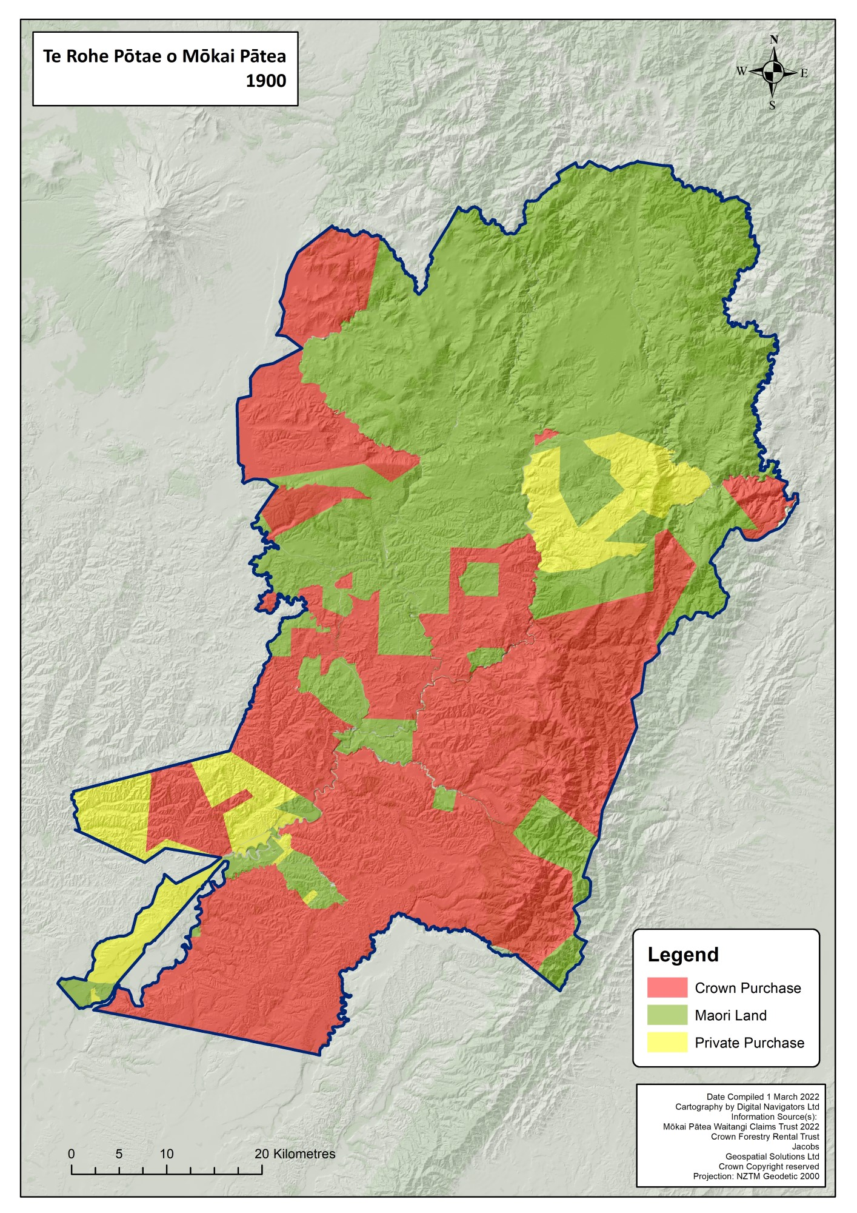
Notes:
Roughly 50% owned by the crown, with some private purchases

Slide 14
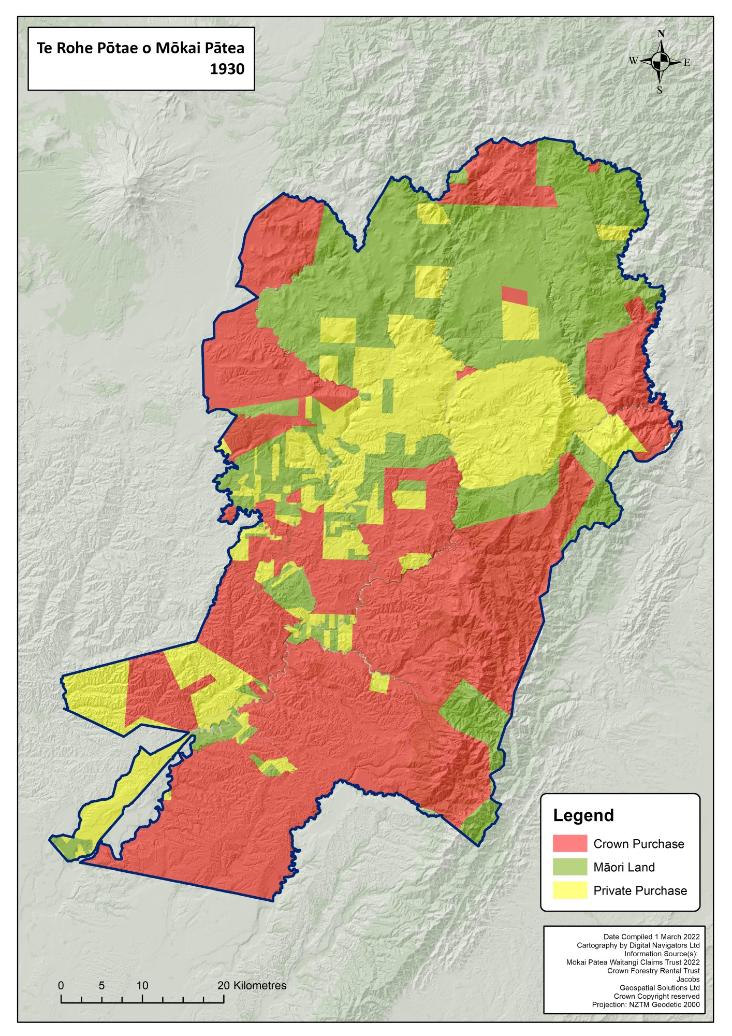
Notes:
Thirty years later 1930 and see further private land purchases in what was left of Māori Land in 1900, roughly 50% of Māori Land in 1900 now private land

Slide 15
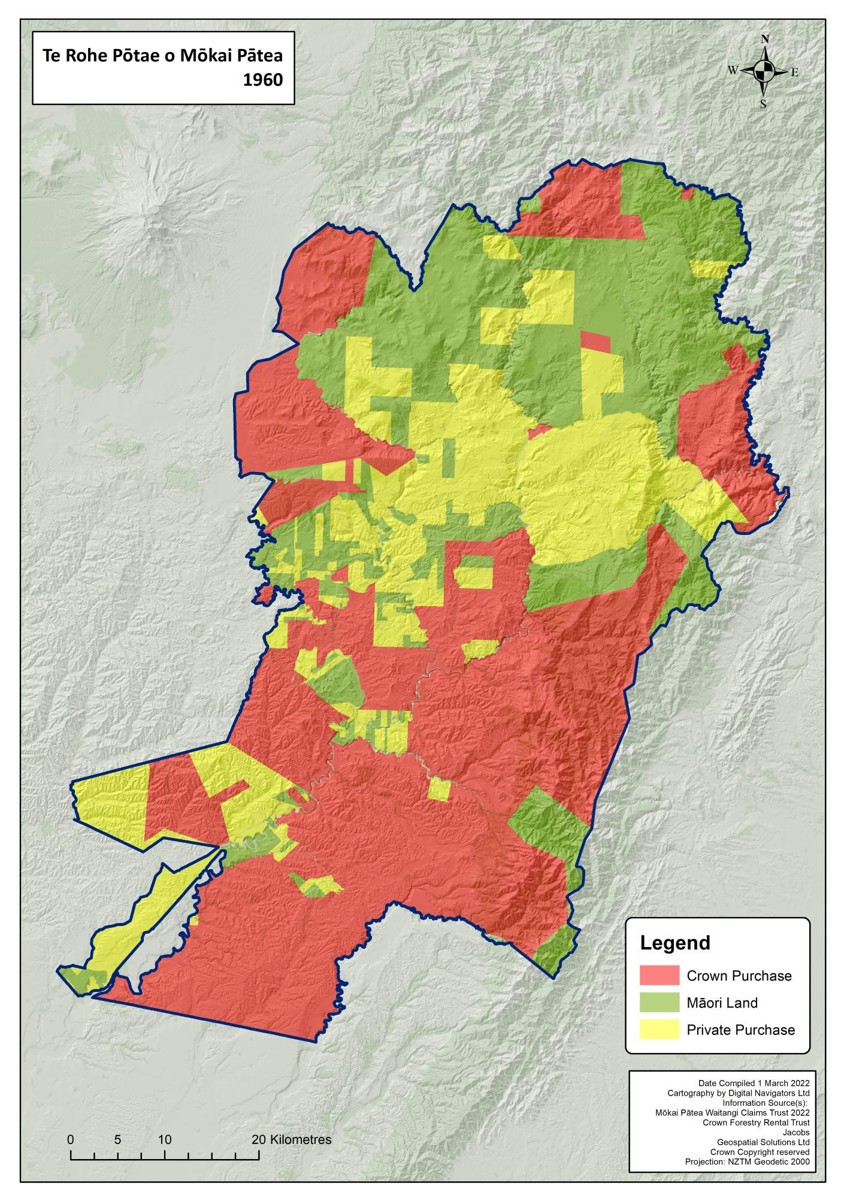
Notes:
Another 30 years 1960 a few more little private land purchased in Northern Blocks

Slide 16
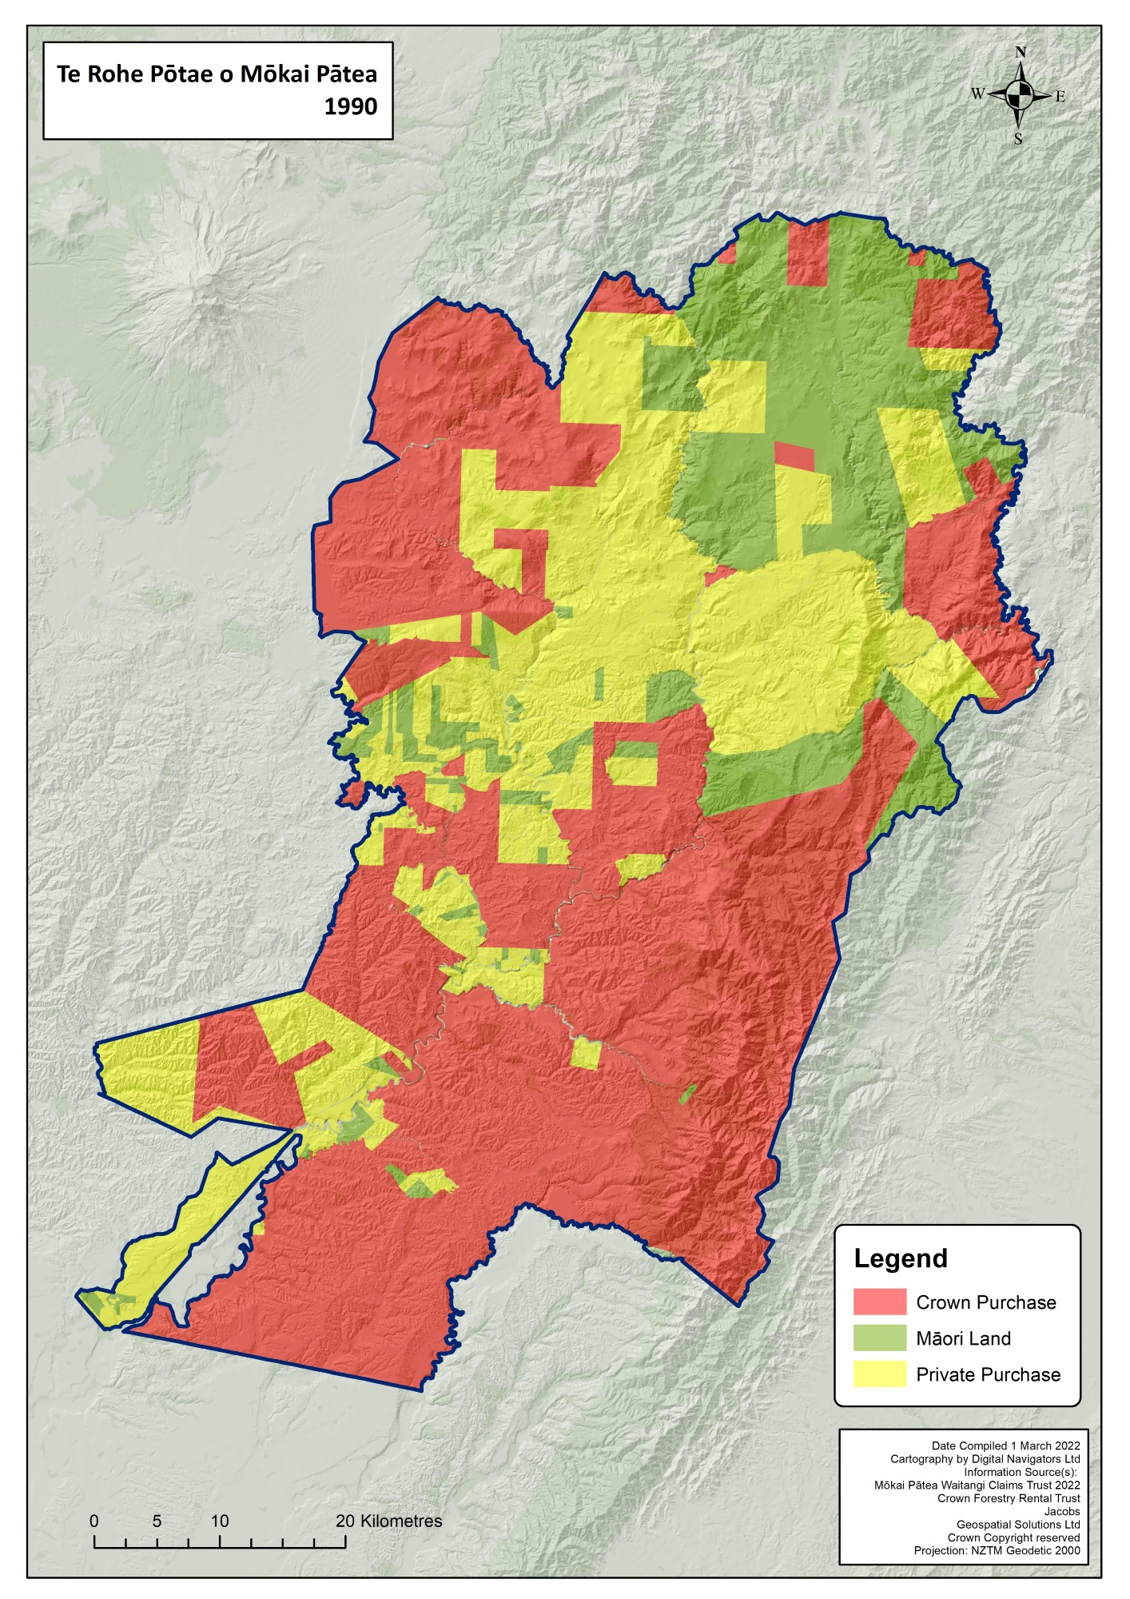
Notes:
Within the next 30 years by 1990 there is more crown taking of land around the WMTA

Slide 17
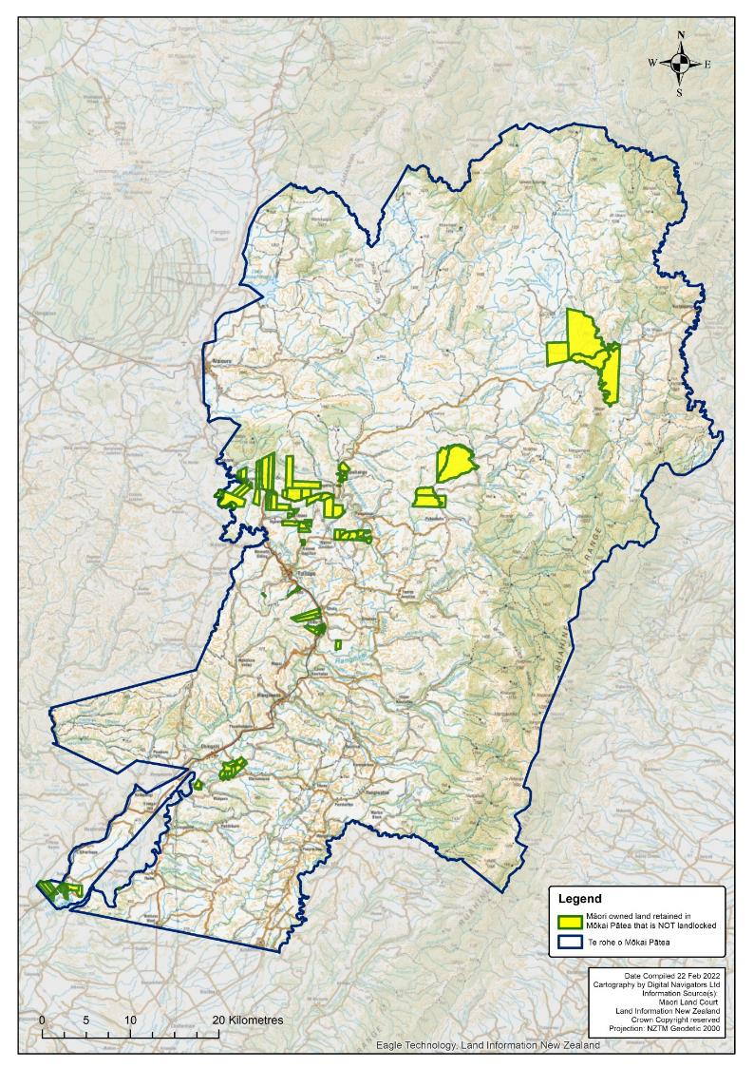
Mōkai Pātea Retained Accessible Māori Land
Notes:
Not Land Locked. Accessible Māori retained land. Circa 4% of the total land area in our inquiry district.

Slide 18
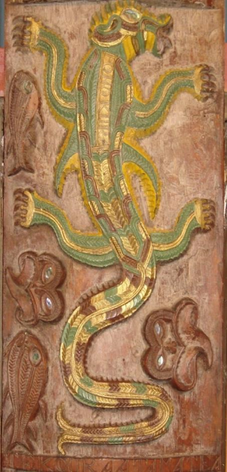
Hau mai i Waitapu
Ō mai i te taumata o Ruahine
Piri mai i Hautapu
Whiti mai i Ngaruroro
Ko Te Iwi Roa
Ko Mōkai Pātea

Slide 19
Q&A Session
Questions using the Q & A button for questions to the panel.
A copy of this presentation and webinar in video format available on Website by end of next week.
https://mokaipateaclaims.maori.nz/documents/
Check your whanau are registered. Register online
https://members.mokaipateaclaims.maori.nz/

